Slide 1

AUGUST 2026
UNESCO Youth Hackathon 2026
🕸️ SOURCE SLEUTH.
VISUAL CITATION MAPPING TOOL
"Don't tell me what to believe. Show me the evidence."

Slide 2


KEY POINTS:
MISINFORMATION CRISIS
DIGITAL ILLITERACY
LACK OF TRUST
THE PROBLEM
In today's digital age, misinformation spreads faster than ever before. 70% of people cannot distinguish between real and fake news, and 60% share articles without reading them first. Traditional fact-checking is slow, complex, and inaccessible to the average person.
70% of people can't tell real from fake news
60% share articles without reading them
Misinformation spreads 6x faster than truth
Media literacy education is lacking globally
━━━━━━━━━━━━━━━━━━━━━━━People are making life decisions based on misinformation.

Slide 3


THE SOLUTION
Source Sleuth is an interactive web platform that maps every claim in a news article to its sources using an intuitive spider web visualization. Just paste a URL or text, and our tool analyzes each claim, fact-checks it, and shows you exactly where the information comes from.
REAL-TIME FACT CHECKING
VISUAL MAPPING
TRUST SCORE
ACCESSIBLE & FREE
Instantly verifies claims using Google Fact Check API
Interactive spider web shows connections between claims and sources
0-100 credibility score with color coding (Green/Yellow/Red)
Voice input, text-to-speech, and multi-language support for everyone

Slide 4
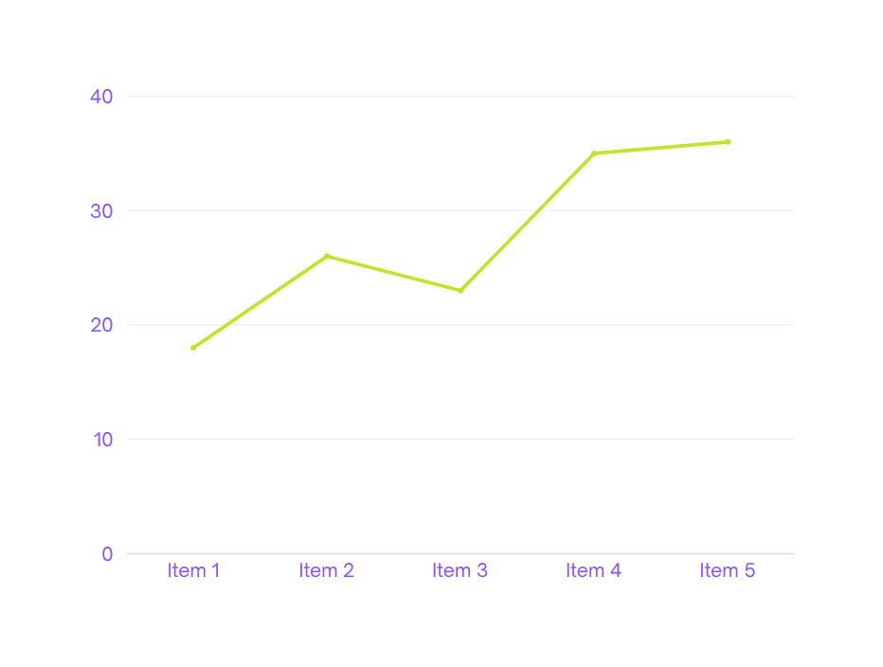
HOW IT WORKS
4 SIMPLE STEPS TO UNCOVER THE TRUTH:
STEP 1: INPUT
└── PASTE URL, PASTE TEXT, OR USE VOICE INPUT
STEP 2: SMART DETECTION
└── SYSTEM AUTO-DETECTS ARTICLE TOPIC AND LOADS RELEVANT DATA
STEP 3: CLAIM ANALYSIS
└── EACH CLAIM IS ANALYZED AND FACT-CHECKED VIA GOOGLE API
STEP 4: VISUAL RESULTS
└── INTERACTIVE SPIDER WEB WITH COLOR-CODED CLAIMS
━━━━━━━━━━━━━━━━━━━━━━━━━━━━━━━━━━━━━━━━━━━━━━━━━━━━━
🟢 VERIFIED | 🟡 WEAK SOURCE | 🔴 UNSOURCED

Slide 5



KEY FEATURES
MULTI-LANGUAGE SUPPORT
5 languages: EN, ES, HI, FR, AR
ANALYSIS HISTORY Save the last 20 analyses in the browser
REAL-TIME FACT-CHECKING
Google Fact Check API integration
INTERACTIVE VISUALIZATION
D3.js spider web with draggable nodes
TRUST SCORE SYSTEM
0-100 credibility score with color coding
VOICE INPUT & TTS
Web Speech API for accessibility
EXPORT & SHARE Download PNG, Export PDF, Share on Social Media
COMPARE FEATURE Compare two articles side by side

Slide 6
  Teach media literacy in schools and universities
  Interactive learning tool for students
  Develop critical thinking skills early
EDUCATION
  Fact-check articles before publishing Quick verification of sources
  Build credibility with readers
JOURNALISM
  Counter misinformation campaigns
  Build public trust through transperancy
  Promote media literacy at scale
GOVERNMENT & NGOS
IMPACT & USE CASES
GENERAL PUBLIC
  Make informed decisions
  Become critical thinkers
  Navigate the digital world confidently
EDUCATION
JOURNALISM
GOVERNMENT & NGOS

Slide 7

TECHNOLOGY STACK
MODERN TECH. OPEN SOURCE. FREE TO USE
FRONTEND
└── HTML5 + CSS3 + JavaScript
└── D3.js (Data-Driven Documents) for visualization
└── Web Speech API (Voice Input & Text-to-Speech)
└── i18n (Multi-Language Support - 5 languages)
└── Local Storage (History & Preferences)
BACKEND
└── Python 3.13
└── Flask 3.1.0 (Web Framework)
└── RESTful API Design
└── Google Fact Check API Integration
└── JSON Data Storage (8 articles, 40+ claims)
WHY THIS STACK?
We chose these technologies because they are:
  Free & Open Source - No licensing costs
  Lightweight - Runs on any laptop
  Scalable - Can handle thousands of users
  Accessible - Easy for anyone to contribute

Slide 8

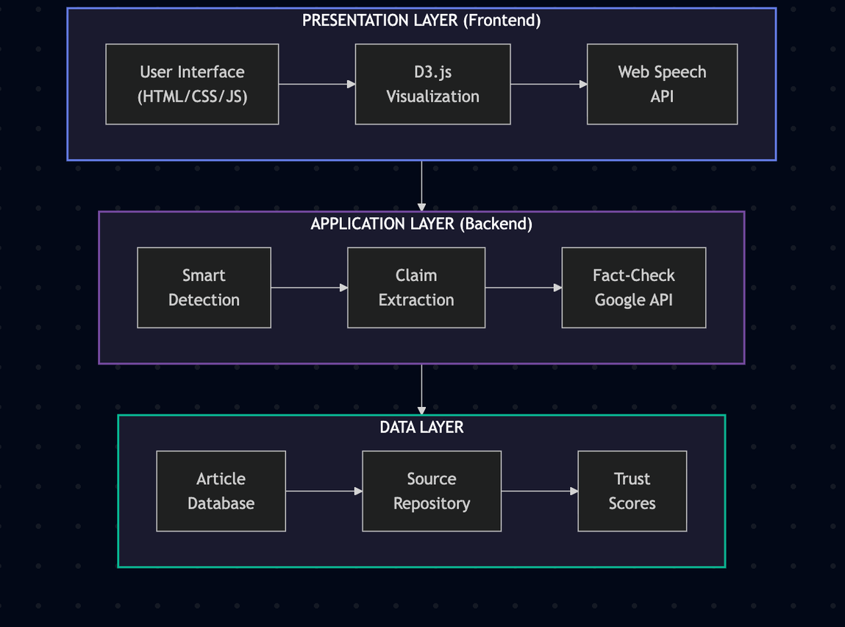

SYSTEM
ARCHITECTURE
FRONTEND BACKEND EXTERNAL SERVICES

Slide 9

  CLEAN INTERFACE
Empty input ready for URL or text
  SMART ANALYSIS
Auto-detects article topic with loading animation
  VISUALIZATION
Spider web with draggable, color-coded nodes
LIVE DEMO HIGHLIGHTS
  TRUST SCORE
Animated 0-100 score with color coding
  CLAIMS BREAKDOWN
Each claim with explanation and sources
  COMPARE FEATURE
Side-by-side article comparison

Slide 10
FUTURE PLANS
Browser Extension
└── Fact-check any article with one click
Mobile App
└── iOS & Android for on-the-go fact-checking
AI & ML Integration
└── Auto-extract claims from any article
CONCLUSION & FUTURE VISION
Community Feature
└── Crowdsourced fact-checking
Educational Module
└── Interactive MIL lessons and quizzes
Blockchain Verification
└── Immutable record of truth
OPEN SOURCE. SCALABLE FUTURE. GLOBAL IMPACT

Slide 11


THANK YOU.

